Slide 1

VA Online Scheduling Stakeholder Monthly Review
January 5, 2020

Slide 2
Agenda:
Meeting purpose
Backend updates
Front end updates
Stakeholder questions and discussion

Slide 3
Northstar Vision
Deliver a seamless and positive experience for
any Veteran who wants to schedule an appointment online.
Objective
Objective
Objective
Increase number of Veterans who are able to successfully request or schedule an appointment
Increase Veteran satisfaction with VA online scheduling experience
Decrease confusion in the online scheduling and appointment management process

Slide 4
VAOSR Product Principles
Veterans see appointments as a single experience. If the feature is not related to scheduling or canceling an appointment, it is a separate product.
Always give users a path forward. No dead ends.
Don’t use VA Online Scheduling to solve staff workflow problems.
Don’t ask VA Online Scheduling to solve bad data problems.
Don’t present Veterans with options they don’t have.
The burden of business rules is on us, not Veterans.

Slide 5
Purpose of the Monthly Stakeholder Demo + Roadmap & Backlog Review
Give the collective VAOS team a place to demo to all VAOS stakeholders what they have done in the past 2 sprints.
Give an overview of the roadmap for the next month, including what is in the backlog, how we are tracking against Program Increment (PI) goals.
Provide a space for stakeholders to discuss and ask questions about the roadmap/backlog, understand areas for escalation, and collectively agree on the direction forward for the next few weeks.

Slide 6
Goals of the Monthly Stakeholder Demo + Roadmap & Backlog Review
At the end of this meeting, participants:
Have seen the recent changes to the application’s front end, backend, and supporting services.
Understand the team’s priorities for the next sprint and how those priorities advance the program increment goals for this product.
Understand where specific user problems to be solved are in the backlog, as well as any related dependencies & blockers.

Slide 7
Stakeholder Expectations for the Monthly Demo + Roadmap & Backlog Review
Attend & be present. (Or, identify a representative on your team who can routinely attend). If you are representing a stakeholder, you have 2 main jobs in this meeting:
Take back applicable updates from this meeting to share with stakeholders/teams.
Follow up on decisions, outstanding questions, and action items assigned to you.

Slide 8
Backend (Apothesource team)

Slide 9
Status and Roadmap Update VAOS-R Services
2021-01-05: January 2021 Status Update

Slide 10
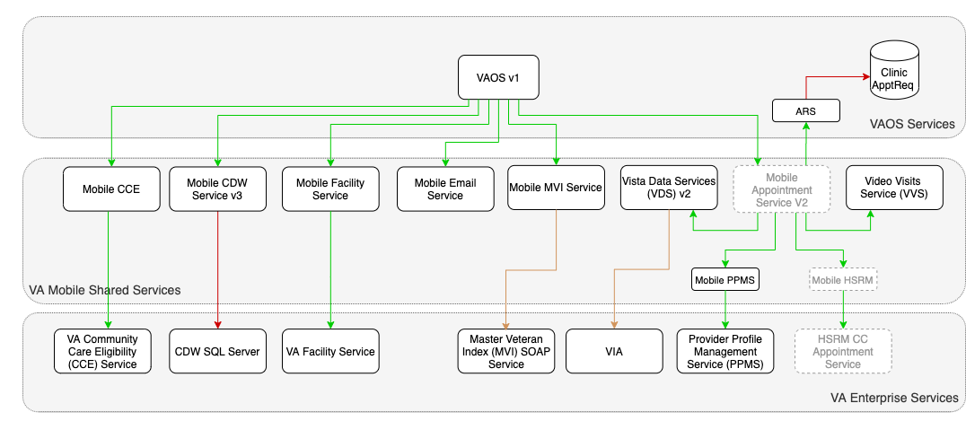
VAOS Milestone 1 (Time to Market/TtM)
Primary Changes:
No EAS/FHIR interface initially
Still provides a (different) path to R4 FHIR-based EAS
Mobile Appointment Service (MASv2) supports full management (read/write) for CC and VistA appointments
Replaces VAOS»VSS interface
VAOS service manages Veteran- and site-specific scheduling rules
Appointment Request Service (ARS) manages VAOS, Express Care appointment requests
Requests serviced through VSE GUI

Slide 11
System Design Document Progress
Tracked as VAOSR-1201
Completed:
Appointment Request Service v1 (Approved)
Mobile Facility Service v2 (Approved)
Mobile HSRM Service v1 (Approved)
Mobile PPMS Service v1 (Approved)
Mobile Appointment Service v2 (Approved)
VAOS Service v1 (In Review)
Mobile HSRM Service v1
Mobile PPMS Service v1
Mobile Facility Service (MFS) v2
Mobile Appt. Service (MAS) v2
Appointment Request Service (ARS) v1
Milestone 1 (TtM)
VAOS v1

Slide 12
Service Implementation Status
Appointment Request Service v1 (ARS)
VAOSR-1189 - Implement searching and fetching requests
VAOSR-1190 - Implement creating a request
VAOSR-1232 - Implement request cancellation (needs work)
VAOSR-1294 - Document VARDB -> ARS model mapping
VAOSR-1399 - Add JWT protections to endpoints
VAOSR-1292 - Add VAR Resources compatibility tests
VAOSR-1397 - Update mapping for reason and comment
Deploy Appointment Request Service 1.0.0
Mobile Facility Service v2 (MFS)
VAOSR-1125 - Implement getFacilities and getFacilityById
VAOSR-1133 - Implement the clinics endpoints
VAOSR-1134 - Implement the clinical services and express care endpoints
VAOSR-1193 - Implement fetching and searching for facility scheduling configurations
Deploy Mobile Facillity Service 2.0.0
Mobile Appointment Service v2 (MAS)
VAOSR-1227 - Add new schema and tables to oracle-test
VAOSR-1233 - Implement searching for VistA/VVS appointments
VAOSR-1291 - Implement direct booking in VistA
Deploy Mobile Appointment Service 2.0.0
VAOSR-1234 - Implement VistA and Express Care requests
Deploy Mobile Appointment Service 2.<next minor release>
VAOS Service v1
VAOSR-142 - Complete VAOS Service SRVDD
Allow direct booking of VistA appointments (needs work)
Allow booking VistA and Express Care appointment requests (needs work)
Deploy VAOS Service 1.0.0

Slide 13
Recent Discussions & Decisions
VistA Appointment Requests
VAR Resources being migrated to use ARS
VistA Appointment Requests / VSE GUI
VSE GUI to manage Veteran-generated appointment requests by connecting to VA Mobile / ARS
SSOi STS Service created; SQA deployment in progress
Cerner Proxy User / Veteran Delegation
Upcoming request to support Veteran delegation through IAM to the My VA Health Portal (i.e. Cerner HealtheLife)
VAOS v1 will not be addressing delegation use cases
Appointment Reminders & Notifications
VAOS v1 will not be sending veteran-facing notifications or reminders

Slide 14
Recent Updates
since 12/15/2020
Appointment Request Service (ARS)
VAOSR-1399: ARS: Add JWT protection to endpoints
VAOSR-1294: ARS: Document VARDB -> ARS model mapping
Mobile Appointment Service (MAS)
VAOSR-1335: MAS V1: Update Vista scheduling call to request clinic details in results
VAOSR-1334: MAS v1: Flag VistA appointments as phone-only
VAOSR-1253: ARB: UPDATE Mobile Appointment Service (MAS) 2.x SRVDD - QA Rejected
VAOSR-1138: MAS: Design MAS v2 interface
VAOSR-1377: MAS v2: Map VVS telehealth info into the new Appointment model
VAOSR-1291: MAS v2: Implement direct booking in VistA
Mobile Facility Service
VAOSR-1110: Deploy Mobile Facility Service 1.10.2
VAOSR-1338: MFS v2: Change hours of operation and and address
VAOS Service
VAOSR-1085: Create VAOS Service SRVDD
VAR Resources
VAOSR-1401: VAR: Include facility ID with request the patient request limit data
VAOSR-1354: VAR Resources: Update to use mongo-test 1.2.1
NGD-8107: Deploy: VAR Resources Release 4.25.1

Slide 15
Front end (VA.gov) team

Slide 16
VA Online Scheduling (VAOS)
on va.gov
Monthly Stakeholder Demo + Roadmap Review
January 5, 2021

Slide 17
Agenda
Review tracking against PI objectives
Demo Community Care Provider Selection MVP
Review Facility Selection improvements
Recap COVID-19 vaccine support
Open items
Roadmap / Backlog

Slide 18
PI Objective Tracking
#1 - Decrease the veteran drop-off rate on the VA facility selection page to improve appointment request completion rate. | Released / Tracking Feedback | Iterating to improve clarity on when/why VA Facility shows
#2 - Improving the Community Care experience so veterans choose from a list of available providers rather than free text. | In Progress | MVP dev complete, pending further guidance around speciality codes
#3 - Improve the usability of the VAOS/VA.gov homepage to increase veteran satisfaction and adoption. | In Progress | Drafted homepage iterations prototype, preparing for research sessions
#4 - Want to develop analytics to track feature use to track where they're having difficulty with the tool. | Discovery / Up Next | Outreach to collect + establish metrics & KPI tracking across groups

Slide 19
DEMO
Community Care Provider Selection MVP

Slide 20
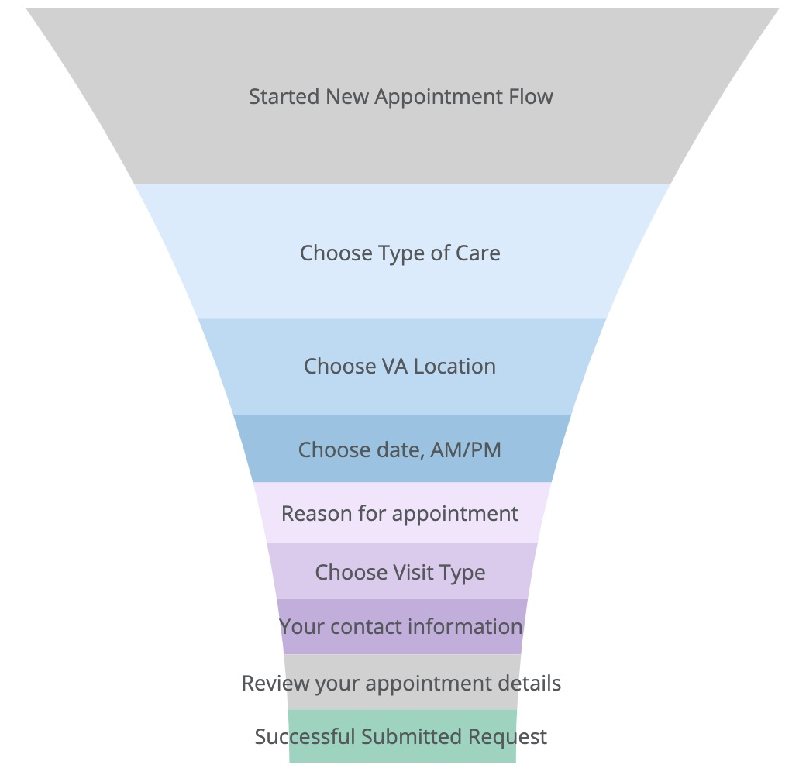
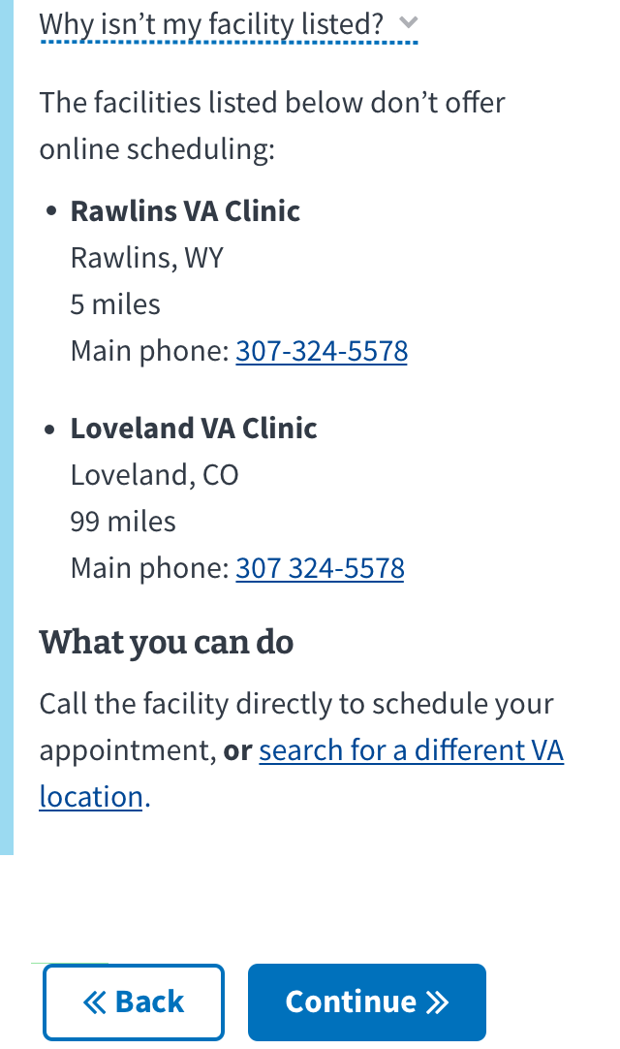
Facility Selection Improvements
Conversion analytics
Facility not listed
Nov vs. Dec
+5.98%
step completion
+2.41%
conversion

Slide 21
COVID-19 Vaccine Support
Scheduling research
Proof of concept

Slide 22
Open Items
Finalized mapping of 6 community care types to the 245+ PPMS Specialty Codes
Tracking potential new initiative for VAOS supporting COVID vaccine distribution

Slide 23
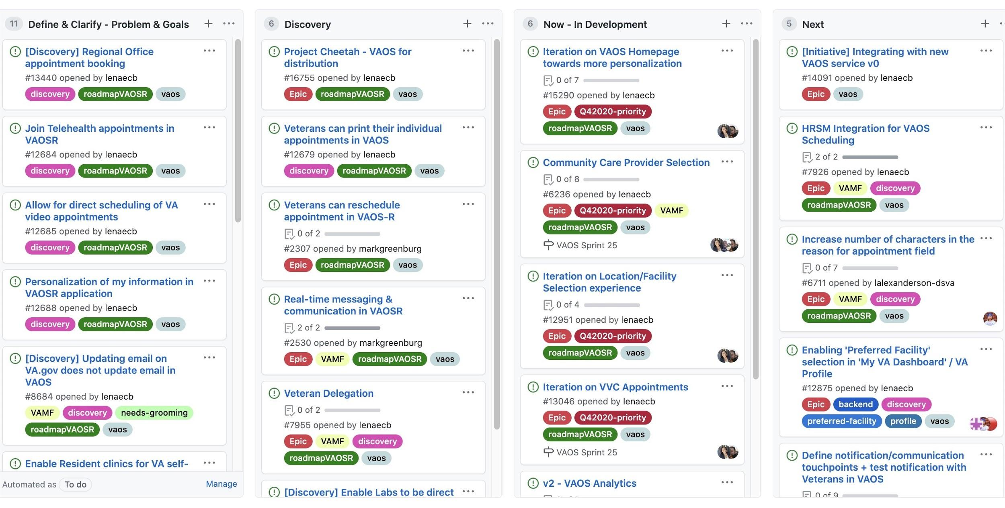
Roadmap / Backlog
https://github.com/department-of-veterans-affairs/va.gov-team/projects/13

Slide 24
Stakeholder - Critical updates, action items, decisions, & questions

Slide 25
Action Items, Questions, & Decisions:
Kay, Steve E. to set up meeting to discuss next steps re Express Care
Shaterri to follow up re: specialty codes. This is a dependency for launch of the community care provider selection feature.
When is HSRM integration?
Awaiting target production date from HSRM team.
Integration testing underway.
Next PI Planning set for January 27/28.
VA Notify is prepared to send all notifications for VA online scheduling – including community care. Need to meet with MHV team to de-duplicate efforts.

